Slide 1
Movie Recommendation System Machine Learning
Done By – Diya.P

Slide 2
Movie recommendation systems play a crucial role in enhancing user experience by providing personalized suggestions, thereby increasing user engagement and satisfaction. In today's vast entertainment landscape, users often face the challenge of choosing from a multitude of options. A robust recommendation system helps users discover content that aligns with their preferences, leading to a more enjoyable viewing experience. Objectives : The primary objectives of our movie recommendation system project are:
Enhance User Experience: Improve the overall user experience by delivering personalized movie recommendations tailored to individual preferences.
Increase User Engagement: Boost user engagement and retention by offering relevant and appealing movie suggestions, ultimately leading to extended platform usage.
Optimize Content Discovery: Address the challenge of content overload by facilitating efficient and personalized content discovery for users.

Slide 3
Problem Statement : The contemporary challenge lies in the overwhelming abundance of movies available across various platforms, making it difficult for users to discover content that aligns with their unique tastes and preferences. Traditional recommendation systems often fall short in providing accurate and personalized suggestions, leading to user frustration and reduced satisfaction. Our project aims to overcome these limitations by developing an advanced movie recommendation system that leverages machine learning algorithms to analyze user behavior, preferences, and historical interactions. Through this, we seek to address the content overload problem and enhance user satisfaction by delivering precise and personalized movie recommendations.

Slide 4
Creating a movie recommendation system using machine learning involves several key steps. Below is a general workflow that we can follow:
Define the Problem:
Clearly articulate the goals and objectives of your recommendation system.
Decide on the type of recommendations (e.g., content-based, collaborative filtering, hybrid) based on your project requirements.
Data Collection:
Gather relevant data for building your recommendation system. This may include user ratings, movie metadata, and user interactions.
Ensure the data is well-structured and clean for effective model training.
Data Preprocessing:
Handle missing values, duplicates, and outliers in the dataset.
Normalize or scale numerical features.
Convert categorical variables into numerical representations if needed.
Explore and understand the distribution of data.
Exploratory Data Analysis (EDA):
Perform exploratory data analysis to gain insights into the characteristics of the dataset.
Visualize the distribution of ratings, user preferences, and movie popularity.
Identify patterns and trends that may influence the recommendation system design.
Feature Engineering:
Extract relevant features from the dataset, such as user preferences, movie genres, and release years.
Create a user-item interaction matrix for collaborative filtering.
Incorporate additional features that may enhance the recommendation system's performance.
Model Selection:
Choose a suitable recommendation algorithm based on your problem and dataset.
Consider using a hybrid approach that combines multiple algorithms for improved accuracy.
Model Training:
Split the dataset into training and testing sets.
Train the selected model on the training data.
User Interface:
Design a user-friendly interface to present recommendations to users.
Implement features like real-time updates, user feedback, and personalization options.

Slide 5
WORK FLOW :-
Data Collection
Data Preprocessing
Feature Extraction
User Input
Cosine Similarity
List of similar movies

Slide 6
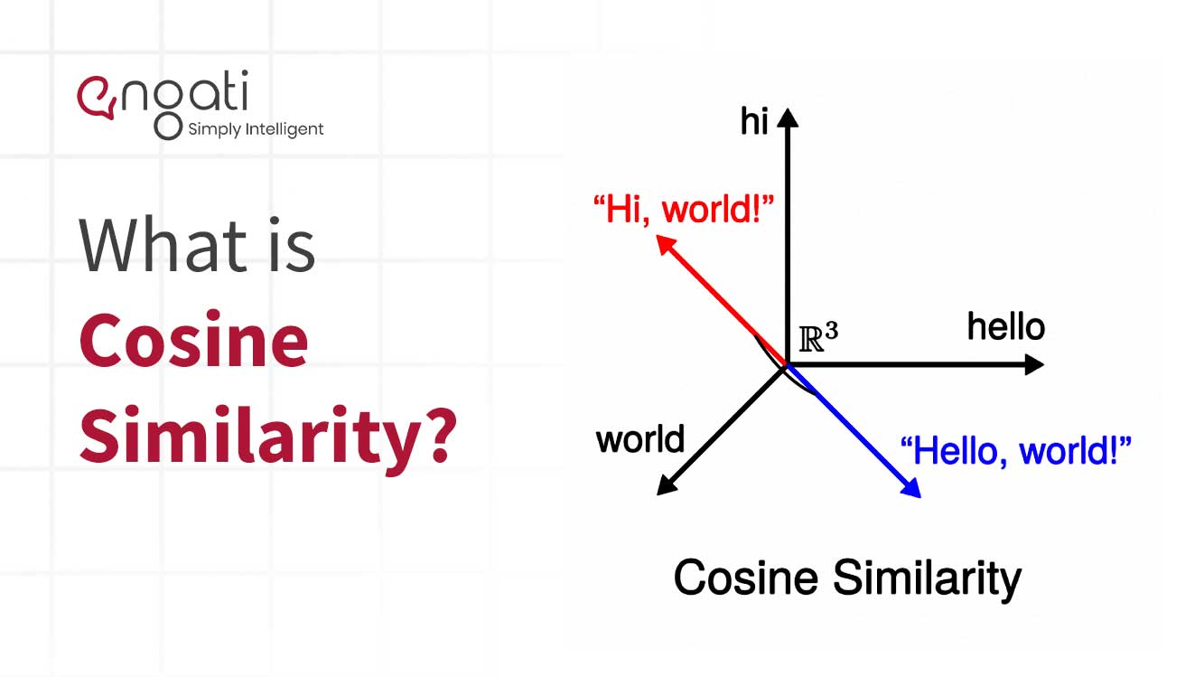
Cosine Similarity :-
Cosine similarity is a measure used to assess the similarity between two movies based on their feature vectors. Feature vectors could include attributes such as genres, directors, or actors. Cosine similarity calculates the cosine of the angle between these vectors, producing a value between -1 and 1. A higher cosine similarity indicates greater similarity between the movies. This method is particularly useful in collaborative filtering, where user preferences are compared to identify movies similar to those the user has liked, aiding in the generation of personalized recommendations.

Slide 7
In the movie recommendation system project, cosine similarity is employed to quantify the likeness between two movies. Feature vectors, representing attributes like genres, directors, or actors, are compared using the cosine of the angle between them. The resulting similarity score ranges from -1 to 1, with higher values signifying greater similarity. This approach is valuable in collaborative filtering, where the preferences of a user are compared to find movies akin to their previous likes. By utilizing cosine similarity, the system can effectively generate personalized recommendations, enhancing the user experience by suggesting movies closely aligned with their tastes and preferences.

Slide 8


